Slide 1
CMPS 254
Linux
Process Management
01/25/16
Operating Systems Internals CMPS254
1

Slide 2
Acknowledgements
All screen captures and examples are produced using the Gedit editor. Gedit editor is released under the GNU General Public License (GPL). See the terms at http://www.fsf.org/licenses/.
01/25/16
Operating Systems Internals CMPS254
2

Slide 3
Objectives
Introduce Processes
Describe processes status
Identify Process Control Block fields
Use ps and kill commands to manage processes
Compare process scheduling techniques
Automate Processes
Use system calls to create processes
01/25/16
Operating Systems Internals CMPS254
3

Slide 4
Introduction
Process –Is a program in execution.
A process requires a set of resources.
Memory space (Stack , Heap)
Control information (PCB)
Environment variables
Hardware (CPU)
Signals
Files (Handles or File Descriptors (in Linux))
01/25/16
Operating Systems Internals CMPS254
4
Notes:
A process is an active entity that runs a program and provides an execution environment for it. It comprises an address space and a control point. Only one process runs on the CPU at a time.
A process requires a set of resources such as address space, CPU time, files, messages, signals and devices.
A process has a defined context comprising all the information needed to describe the process. The process context has the following components
User Address Space : executable code, data user ,stack and share memory regions
Control Information : The kernel uses two main data structures to maintain control information the User area and proc structure . Each process also has its own kernel stack and address translation maps.
Credentials : The credentials of the process include the user and groups Ids associated with it
Environment variables : These are set of strings of the form variable = value, which are inherited from the parent
Hardware context : This includes the contents of the registers such as :Program counter (PC), Stack pointer (SP), The processor status word (PSW), Memory Management Registers, Floating point Unit registers (FPU).
Reference: Uresh Vahalia, Unix Internals The New Frontiers,

Slide 5
Process Address Space
01/25/16
Operating Systems Internals CMPS254
5

Slide 6
Process Control Block (PCB) - /proc
Information associated with each
process
Process state
CPU state
Program counter
CPU registers
CPU scheduling information
Memory-management information
Accounting information
I/O status information
01/25/16
Operating Systems Internals CMPS254
6

Slide 7
PCB - /PROC
During the initialization phase of Linux, the star_kernel( ) creates kernel thread, named process 1 ( init process)
To allow an efficient search through processes of a given type , the kernel creates several lists of processes
Each list consists of pointers to process descriptors (Process Control Block)
01/25/16
Operating Systems Internals CMPS254
7

Slide 8
Processes Types
OS typically has many processes running
System processes
User processes
01/25/16
Operating Systems Internals CMPS254
8
Notes:
8
This an example that represents the different types of processes.
In modern Operating systems , several processes are active in the system concurrently . To these processes, the system provides some features of virtual machine. The programmer writes an application as if only its code were running on the system.
A CPU can run either in User mode or in Kernel mode. When a program is executed in User mode, it cannot directly access the kernel data structures.
Each process runs in its private address space. A process running in User mode refers to private stack, data and code areas. When running in kernel mode, the process addresses the kernel data and code area and makes use of another stack
Note
Show some example of System processes and User processes using PS command or in windows Task Manager

Slide 9
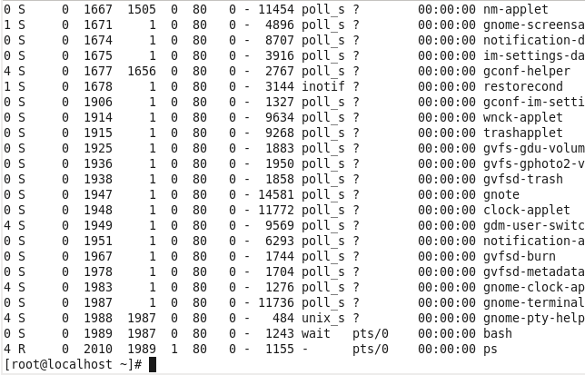
Process Types
System Processes
User Processes
01/25/16
Operating Systems Internals CMPS254
9
Notes:
“Screen Capture of Linux PS command is released under the GNU General Public License (GPL). See the terms at http://www.gnu.org/licenses/license-list.html”
9

Slide 10
Process Types
Daemon process: is a process running in the background, typically starts when the system is booted and runs for the life of the system.
E.g: automountd, nfsd, dhcpd, httpd
01/25/16
Operating Systems Internals CMPS254
10
Notes:
10

Slide 11
Parent /Child Process Structure
Processes in Linux have parent and child structure
Each process has one parent and can also have one or more child processes
Init process is the first user process created when the system boots.(/etc/init)
When parent process exits, all child processes are inherited by init. This type of processes are called Orphan processes
01/25/16
Operating Systems Internals CMPS254
11

Slide 12
Ps Command
ps
ps –a
ps -A
ps –al
ps –fa
ps –ax | head -25
ps -Al | grep bash
ps aux | grep bash
ps -Ao pid,s,cmd > out
ps –Ao pid,s,cmd | grep bash
01/25/16
Operating Systems Internals CMPS254
12
Notes:
12

Slide 13
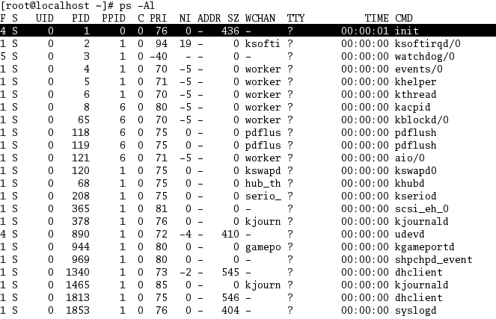
First User Process INIT
01/25/16
Operating Systems Internals CMPS254
13
Notes:
13
“Screen Capture of Linux PS command is released under the GNU General Public License (GPL). See the terms at http://www.gnu.org/licenses/license-list.html”

Slide 14
Process Attributes
To display ALL Processes attributes use ps –Al command
The following are some Processes Attributes:
F Flags
S State
PID Process ID
PPID Parent Process ID
C Class
PRI Priority
NI Nice value
TIME CPU Time
CMD Process Name
01/25/16
Operating Systems Internals CMPS254
14
Notes:
14

Slide 15

Process Attributes
01/25/16
Operating Systems Internals CMPS254
15
Notes:
“Screen Capture of Linux PS command is released under the GNU General Public License (GPL). See the terms at http://www.gnu.org/licenses/license-list.html”
15

Slide 16
Process Attributes
If you want to display only specific process attributes or columns use the –o option with ps command.
e.g. ps -Ao cmd,pid,s > outputfile
This command will display ALL processes names, process IDs and its states only and redirects the results to an outputfile.
The –o option is a user-defined format that allows to specify individual output columns. In this case the Process name the ID and the State
01/25/16
Operating Systems Internals CMPS254
16

Slide 17
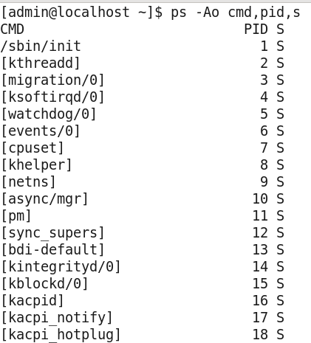
PS command and –o option
01/25/16
Operating Systems Internals CMPS254
17
Notes:
“Screen Capture of Linux PS command is released under the GNU General Public License (GPL). See the terms at http://www.gnu.org/licenses/license-list.html”
17

Slide 18
Processes States
As a process executes, it changes its status
new: The process is being created.
running: Instructions are being executed.
waiting: The process is waiting for some event to occur.
ready: The process is waiting to be assigned to a processor (CPU)
terminated: The process has finished execution.
running
1
3
2
Waiting
Ready
4
01/25/16
Operating Systems Internals CMPS254
18
Notes:
18
Slide 12 explains the transition between process states . The possible transitions are:
Ready to Running (When scheduled)
Running to Ready (when a process is preempted )
Running to Waiting (When an even occurs or I/O request)
Waiting to Ready ( When I/O operation is completed and processing has to be resumed )
The transition Waiting to Running is not possible. I order to move to the Running queue a process has to be in Ready queue
Reference :Tanenbaum ,Modern operating systems

Slide 19
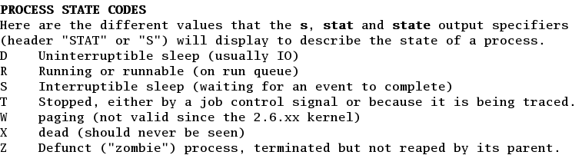
Linux Process’ States
01/25/16
Operating Systems Internals CMPS254
19
Notes:
19
“Screen Capture of Linux man ps command is released under the GNU General Public License (GPL). See the terms at http://www.gnu.org/licenses/license-list.html”
The states in Linux are:
Running: The processes is executed or ready to execute
Interruptible: The process is suspended . The process is waiting for an event such as I/O operation , resource availability or signal from another process
Uninterruptible: A blocked state. A process is waiting directly on hardware conditions and therefore will not accept any signal. This state may be used when a process opens a device file and the corresponding device driver starts probing for a corresponding hardware device. The device driver cannot be interrupted until the probing is complete .
Stopped: The process has been halted and can only resume by a positive action from another process. Example a process that is being debugged can be put in stopped state
Zombie: Process execution is terminated, but the parent process has not yet issued a wait system call to return information about the dead process .
Reference :From Understanding the Linux Kernel, Daniel Bovet and Marco Cesati

Slide 20
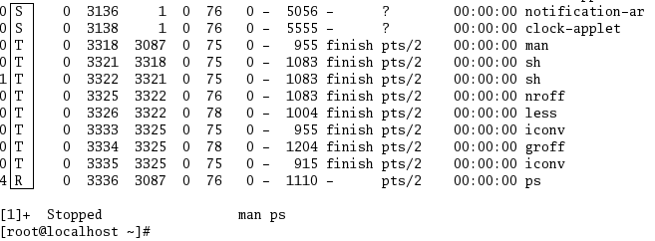
Process’ States
01/25/16
Operating Systems Internals CMPS254
20
Notes:
20
“Screen Capture of Linux PS command is released under the GNU General Public License (GPL). See the terms at http://www.gnu.org/licenses/license-list.html”

Slide 21
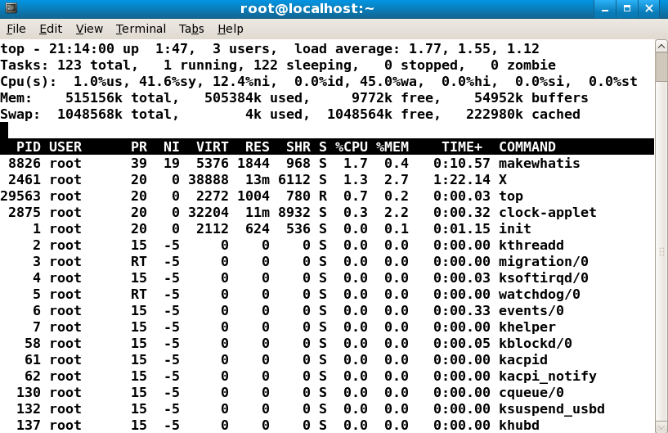
Top program to trace processes
01/25/16
Operating Systems Internals CMPS254
21
Notes:
21
“Screen Capture of Linux top command is released under the GNU General Public License (GPL). See the terms at http://www.gnu.org/licenses/license-list.html”

Slide 22
Ps command and pipes
ps command can be piped with other commands to filter data
e.g. ps –A | wc –l
In this example ps was piped with wc (word count) to display the number of lines in ps program
01/25/16
Operating Systems Internals CMPS254
22

Slide 23
Ps command and pipes
e.g. ps –Ao cmd,s | grep 'R'
In this example ps extracts only processes names and its state and passes that to grep command
grep command will search and display only the lines that contain R string (Processes that are in running state, or processes which have the letter R in their command line)
01/25/16
Operating Systems Internals CMPS254
23

Slide 24
Processes Management
In Linux systems, a program is executed by a child process
Child process executes in parallel with its parent process. The parent process can execute wait() system call, which blocks (i.e., the parent process is stopped) until the child process terminates.
Once the child process exits, the kernel sends the parent process signal SIGCHLD.
01/25/16
Operating Systems Internals CMPS254
24
Notes:
24

Slide 25
Zombie and Orphan Processes
The child process stays in zombie state, until the parent process reads its exit status using the wait() system call
If a parent process terminates before its child process terminates, the child process becomes an orphan process, and is assigned to parent process 1, the init process.
01/25/16
Operating Systems Internals CMPS254
25

Slide 26
Process Termination
Conditions which terminate processes
Process calls the exit() system call, with status 0 for normal exit, or status of non-zero for error exit. (voluntary exit)
Process receives a signal for which it did not register a handler, or was not permitted to register a handler for that signal (e.g., the KILL signal)
01/25/16
Operating Systems Internals CMPS254
26
Notes:
26
When a process dies , the kernel must be notified , so it can release the resources own by the process.
A process can be terminated by exit() system call (voluntary). This system call may be inserted by the programmer explicitly . The exit() system call is executed when the control flow reaches the last statement of the procedure main() in C programs
A process can also terminated involuntary by the kernel . This occurs when has received a signal that cannot handle or ignore or when unrecoverable CPU exception has been raised in Kernel Mode . (Executing illegal instruction , dividing by zero, accessing illegal address space)
The exit function performs the following actions:
Turns off all signals
Closes all open files
Releases the text file and other resources such as the current directory
Saves resources statistics and exit status in the proc structure
Changes state to ZOMBIE and puts the proc structure (PCB) in the zombie process list
Makes the init process inherit any live children of the existing process
Releases address space, user area, swap space, address translation maps
Notifies the parent by sending SIGCHLD signal
Wakes up the parent if it is asleep
Finally calls Swtch() context switch to schedule a new process to run

Slide 27
Kill command to Terminate processes
A process can be terminated by sending interrupt or termination signals
kill command is used to send signals to a process
Kill Syntax:
kill code PID
The code of each signal can be found with
Kill –l command
01/25/16
Operating Systems Internals CMPS254
27
Notes:
27

Slide 28
Kill command examples
e.g. kill -9 1525
In this example the kill command will send SIGKILL and terminate immediately (resources are terminated instantly) the process with ID 1525
kill -15 3246
In this example the kill command will send SIGTERM and terminate the process with ID 3246 properly ( All resources are closed properly)
Kill -19 2401
In this example the kill command will send SIGSTOP and suspend the process with ID 2401
01/25/16
Operating Systems Internals CMPS254
28

Slide 29
Signals
SIGTERM (kill -15) terminates processes, the process is allowed to close files in a proper way.
If the code is not specified with the kill command the system will use the default signal code -15
e.g. kill 1245
In this case there is not code specified then the system will use SIGTERM signal (-15) which is the default signal and terminates the process 1245 properly
01/25/16
Operating Systems Internals CMPS254
29
Notes:
29

Slide 30
Signals
SIGSTOP: ( kill -19) stop signal. It suspends processes. These processes can be resumed.
SIGKILL ( kill -9) process terminated immediately without closing resources properly. Files opened by the process can be damaged while terminating the process, as the file buffers are not flushed to the disk.
SIGHUP (kill -1) hungup (networking)
01/25/16
Operating Systems Internals CMPS254
30

Slide 31
Signals
There are different ways to send signals to process:
1. kill command
2. Use shortcuts combining keyboards keys
3. At the programming level use the signal name such as SIGTERM, SIGKILL, SIGSTOP
Keyboard kill Signal Name
Ctrl-c kill -2 SIGINT
Ctrl-z kill -19 SIGSTOP
Ctrl-\ kill -3 SIGQUIT
Ctrl-u kill -9 SIGKILL
01/25/16
Operating Systems Internals CMPS254
31

Slide 32
Process running in the foreground
A process running in the foreground has control of the terminal. Anything typed on the terminal is input to the process. When the process terminates, control of the terminal is returned to the shell.
e.g man ps
The current terminal can not be used until you terminate this process by pressing the letter q
01/25/16
Operating Systems Internals CMPS254
32

Slide 33
Process running in the background
When a process needs to run for long periods of CPU time, it can run in the background, with the shell having control of the terminal so other programs can be started
There are several ways to run a process in the background:
1. Use & symbol at the end of the command line used to start the process
2. Press ctrl-z key to stop the current foreground process, then give the shell the bg [job] command to run it in background.
01/25/16
Operating Systems Internals CMPS254
33

Slide 34

Process running in the background
You can use the & symbol to start a process in the background.
In this example the man process is running in the background.
[1] – Is the job Number
13072 - Is the process ID
01/25/16
Operating Systems Internals CMPS254
34
Notes:
34
“Screen Capture of Linux man pwd command is released under the GNU General Public License (GPL). See the terms at http://www.gnu.org/licenses/license-list.html”

Slide 35
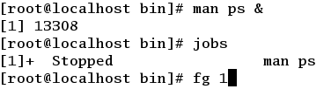
Process running in the background
A process running in the background can be brought to the foreground using the following command fg Job-Number
To find the job number use the jobs command
01/25/16
Operating Systems Internals CMPS254
35
Notes:
35
“Screen Capture of Linux jobs and fg commands is released under the GNU General Public License (GPL). See the terms at http://www.gnu.org/licenses/license-list.html”

Slide 36
Process’ Priority
Each process running in the system has a priority value
The priority value is used by the scheduler to choose next process to give the CPU to.
Process priority is an integer value
Higher numbers means lower priority
The priority (PRI column) of a process can be modified by changing the value of nice (NI column)
01/25/16
Operating Systems Internals CMPS254
36
Notes:
36

Slide 37
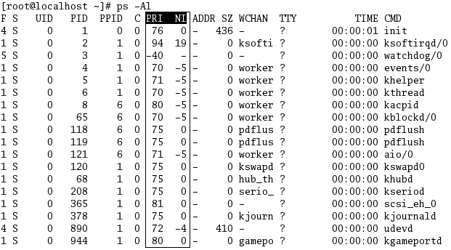
PRI and NICE Values
01/25/16
Operating Systems Internals CMPS254
37
Notes:
37
“Screen Capture of Linux PS command is released under the GNU General Public License (GPL). See the terms at http://www.gnu.org/licenses/license-list.html”

Slide 38
NICE Value
The system uses nice attribute to determine process priority compared to other processes.
By increasing the value of nice we will decrease process’ priority and vice
Default value of nice = 0
Nice range is -20 > Nice < 19
01/25/16
Operating Systems Internals CMPS254
38
Notes:
38

Slide 39
NICE (NI) value
Every process has a nice number along with the execution priority.
Nice value is used to assign priority to a new process
Renice value is used to modify priority of an existing process
01/25/16
Operating Systems Internals CMPS254
39

Slide 40
Nice and Renice examples
e.g nice -n -10 sh
Increases sh process priority by 10 units
nice -n 10 sh
Decreases sh process priority by 10 units
renice -n -10 2510
Increases the priority of process with 2510 ID by 10 units
renice -n 10 2510
decreases the priority of process with 2510 ID by 10 units
01/25/16
Operating Systems Internals CMPS254
40

Slide 41
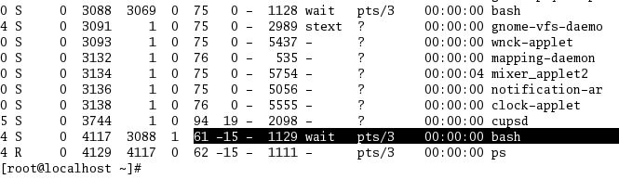
Nice a new process
e.g. nice –n -15 bash
In this example the nice command will
create a new bash process with high priority
01/25/16
Operating Systems Internals CMPS254
41
Notes:
41
“Screen Capture of Linux PS command is released under the GNU General Public License (GPL). See the terms at http://www.gnu.org/licenses/license-list.html”

Slide 42
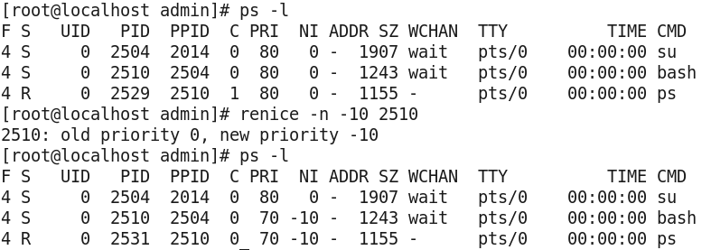
Renice an existing process
01/25/16
Operating Systems Internals CMPS254
42
Notes:
“Screen Capture of Linux PS command is released under the GNU General Public License (GPL). See the terms at http://www.gnu.org/licenses/license-list.html”
42

Slide 43
Process Automation
You can set up many system tasks to execute automatically. Some of these tasks should occur at regular intervals. Other tasks need to run only once, perhaps during off hours such as evenings or weekends.
crontab and at commands can be used to schedule routine tasks to execute automatically.
The at command schedules tasks that execute once at particular date
The crontab schedules repetitive commands.
01/25/16
Operating Systems Internals CMPS254
43
Notes:
43

Slide 44
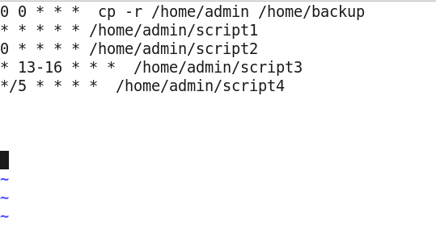
Crontab
01/25/16
Operating Systems Internals CMPS254
44
Notes:
“Screen Capture of Linux crontab command is released under the GNU General Public License (GPL). See the terms at http://www.gnu.org/licenses/license-list.html
44

Slide 45
Process Creation
Parent process create children processes, which, in turn create other processes, forming a tree of processes
Generally, process identified and managed via a process identifier (pid)
Resource sharing
Parent and children initially share all resources
Children share subset of parent’s resources
Parent and child share no resources
Execution
Parent and children execute concurrently
Parent can choose to wait() until children terminate
01/25/16
Operating Systems Internals CMPS254
45

Slide 46
Process Creation
Address space
Child is duplicate of parent just after fork() system call. Code segment is shared, data segments are copied on first write.
Child could call exec() and replace itself with another program.
UNIX examples
fork system call creates new process
exec system call used after a fork to replace the process with a new program
01/25/16
Operating Systems Internals CMPS254
46

Slide 47
Process Creation
Processes are created by fork and vfork system call.
The fork system call must perform the following:
Copy the image of the calling process in memory
Allocate a new PID and proc structure for the child
Initialize the child’s proc and hardware context
Allocate address Translation maps for the child
Make the child runnable and put it on scheduler queue
Return to child from fork with a value of zero
Return the PID of the child to the parent
01/25/16
Operating Systems Internals CMPS254
47
Notes:
The fork () system call creates a new process. The process that calls fork() is the parent, and the new process is its child. The parent-child relationship creates the process hierarchy. The child process is almost an exact clone of the parent. Its address space is a replica of that of the parent , and it also runs the same program initially.
Because the parent and child both return from the fork and continue to execute the same program, they need a way to distinguish themselves from one another and act accordingly. For this reason , the fork system call returns different values to the parent and child- fork returns 0 to the child, and the child’s PID to the parent.
Reference: Uresh Vahalia, Unix Internals The New Frontiers

Slide 48
Linux Process Management
child process
text
fork
execve
stack
child
text
Unix
kernel
stack
wait
Unix
kernel
exit
01/25/16
Operating Systems Internals CMPS254
48

Slide 49
Processes’ system calls
Linux is a multiprogramming environment, and many processes are active in the system at any time
The fork system call creates a new process.
The exec program runs a new program
The wait system call allows a process to wait for a child to terminate
The exit system call terminates a process
01/25/16
Operating Systems Internals CMPS254
49
Notes:
The process has a definite lifetime-most processes are created by a fork or vfork system call and run until they terminate by calling exit. During its life time, a process may run one or many programs. It invokes the exec system call to run a new program .
Upon successful completion of exec, the child’s address space is replaced with that of the new program, and the child returns to user mode with its program counter set to the first executable instruction of the new program.
Between the fork and exec, the child may perform a number of tasks to ensure that the new program is invoked in the desired state.
The fork must give the child a logically distinct copy of the parent’s address space. In most cases the child discards this address space when it calls exec or exit shortly after the fork. It is a wasteful to make an actual copy of the address space. This problem has been addressed with the copy-on-write approach . In this method the child receives its own copy of the address translation maps, but share the memory pages with the parent. If either the parent or the child tries to modify a page, a page fault exception occurs. The handler recognizes that is a copy-on-write page and makes a new writable copy of that single page and does not need to copy the entire address.
Reference :Uresh Vahalia, Unix Internals The New Frontiers

Slide 50
fork()
Create a process
#include <unistd.h>
int fork() (No arguments)
Output
-1 for error
0 to child process
Pid pid of child to parent process
01/25/16
Operating Systems Internals CMPS254
50

Slide 51
fork( ) -Example
#include <stdio.h>
#include <unistd.h>
#include <stdlib.h>
#include <sys/types.h>
void
main ()
{
int pid;
fprintf(stderr, "My PID is %d\n", getppid());
pid = fork();
fprintf(stderr, "fork() returned %6d, and my PID is %6d\n", pid,getppid());
pid = fork();
fprintf(stderr, "fork() returned %6d, and my PID is %6d\n", pid,getppid());
pid = fork();
fprintf(stderr, "fork() returned %6d, and my PID is %6d\n", pid,getppid());
}
01/25/16
Operating Systems Internals CMPS254
51

Slide 52
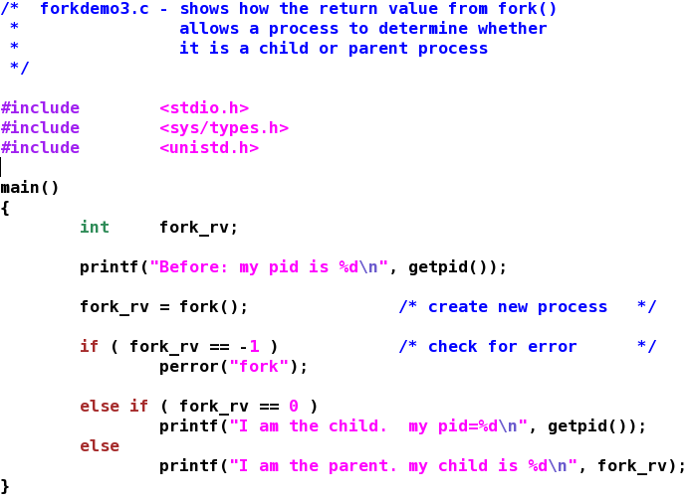
Parent /Child Processes Program
01/25/16
Operating Systems Internals CMPS254
52

Slide 53
exec()
Executes a program with path searching
#include <unistd.h>
execvp( const char *file, const char *argv[])
*file pointer to the file(program to execute)
*argv[] array of strings
Example
execvp( arglist[0], arglist )
execvp( “ls” , arglist )
01/25/16
Operating Systems Internals CMPS254
53

Slide 54
exec() family
Exec has different functions
execvp() is a library function that calls execve() e- environment to invoke kernel services
execlp ( “ls “, “ls”, “-a”, NULL) does not pass arguments to main as argv[], instead are arguments of execlp()
Execv(fullpath, arglist) is like execvp except it does not search for the file in the search path. The first argument has to be the exact path to the program to run
01/25/16
Operating Systems Internals CMPS254
54

Slide 55
wait() System call
Wait() system call performs the following operations:
Stops the calling process until a child processes terminates its job
Retrieves the value the child process had passed to exit
Returns PID of the child that called exit
01/25/16
Operating Systems Internals CMPS254
55

Slide 56
wait(&status)
Wait for process termination
#include <sys/types.h>
#include <sys/wait.h>
int wait( int &child_status)
int wait( NULL )
Return
-1 if error
Pid of terminated process (child process)
01/25/16
Operating Systems Internals CMPS254
56

Slide 57
exit() system call
Child process terminates its task and calls exit(n), where 0<=n<=255
Exit system call performs the following operations:
Close all file and directory descriptors
Change the parent PID of all children to the PID of init
Send the parent SIGCHLD
01/25/16
Operating Systems Internals CMPS254
57

Slide 58
exit()
Terminates the current process
#include <unistd.h>
#include <stdlib.h>
exit(int 0-255)
Example
if ( fork() != 0 )
exit(0);
01/25/16
Operating Systems Internals CMPS254
58

Slide 59
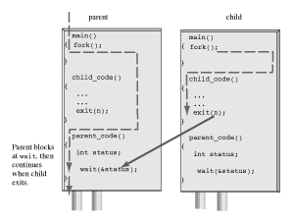
Wait () and Exit () system calls
01/25/16
Operating Systems Internals CMPS254
59

Slide 60
SIGNALS
The process that receives a signal can take one of the following actions:
Ignore the signal (SIG_IGN)
Perform the default action (SIG_DFL)
Catch the signal (function-name)
signal( SIGNAL-NAME, ACTION)
signal ( SIGINT, SIG_IGN)
01/25/16
Operating Systems Internals CMPS254
60

Slide 61
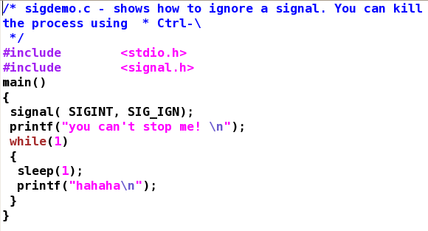
Signals –system calls
01/25/16
Operating Systems Internals CMPS254
61

Slide 62
Summary
Process attributes
Process status
Process control block
Process management using ps command
IPC –Inter-process communication
Processes and signals
Processes Schedule
Process Automation
Process Creation using fork, wait, exit and exec system calls
01/25/16
Operating Systems Internals CMPS254
62

Slide 63
Commands Summary
ps
top
kill
nice
renice
wc
jobs
fg
01/25/16
Operating Systems Internals CMPS254
63

Slide 64
References
Silberschatz, Galvin and Gagne, Operating System Concepts, John Wiley & Sons, latest edition.
Chapter 3 - Processes
Chapter 21
Process Management
Inter-process Communication
01/25/16
Operating Systems Internals CMPS254
64

Slide 65
Acknowledgements
All screen captures and examples are produced using the Gedit editor. Gedit editor is released under the GNU General Public License (GPL). See the terms at http://www.fsf.org/licenses/.
01/25/16
Operating Systems Internals CMPS254
65

